Slide 1

CSE347
Information System Analysis and Design
Md Sabbir Hossain
Lecturer
Department of Computer Science and Engineering
Faculty of Science and Engineering

Slide 2
Topic
System Architecture and Component Diagram Design
2

Slide 3
INTRODUCTION
Behavior diagrams
A type of diagram that depicts behavior of a system
This includes activity, state machine, and use case diagrams, interaction diagrams
Interaction diagrams
A subset of behavior diagrams which emphasize object interactions. This includes
collaboration, activity, sequence diagrams
Structure diagrams
A type of diagram that depicts the elements of a specification that are irrespective of time. This includes class, composite structure, component, deployment
UML components diagrams are structure diagrams

Slide 4
Component Diagram
A component is an encapsulated, reusable, and replaceable part of your software
Reducing and defying coupling between software components
Reusing existing components
The ability to identify software components (which are
encapsulated, reusable and replaceable) supports
development strategies that use, e.g., COTS (Commercial- Off-The-Shelf)
components.

Slide 5
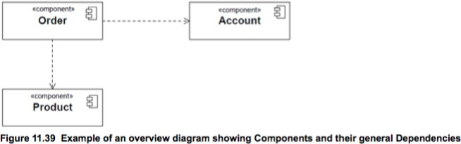
Component Diagram
A Component is a self-contained unit that encapsulates the state and behavior of a number of Classifiers.
In UML, a Classifier represents a classification of instances according to their Features.
For instance: a category of entities in the domain
A classifier has attributes

Slide 6
Component diagram
Component Diagrams can show how subsystems relate and which interfaces are implemented by which component.
A Component Diagram shows one or more interfaces and their relationships to other components.
A Component Diagram shows the dependencies among software components, including source code, binary code and executable components.
Some components exist at compile time, some exist at link time, and some exist at run time; some exist at more that one time.

Slide 7
Component Modelling
Find components and dependencies
Identify and level subcomponents
Clarify and make explicit the interfaces between components

Slide 8
When to use component diagrams
Use component diagrams when you are dividing your system into components and want to show their interrelationships through interfaces or the breakdown of components into a lower-level structure.

Slide 9
How to produce component diagrams
Decide on the purpose of the diagram
Add components to the diagram, grouping them within other components if appropriate
Add other elements to the diagram, such as classes, objects and interfaces
Add the dependencies between the elements of the diagram

Slide 10
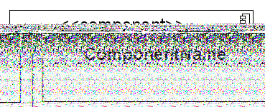
Component notation
A Component is a physical piece of a system, such as a compiled object file, piece of source code, shared library or Enterprise Java Bean (EJB).
Note that UML 2.0 uses a new notation for a component. Previous UML versions use the component icon as the main shape.

Slide 11


COMPONENT NOTATION
A component is shown as a rectangle with
A keyword <<component>>
Optionally, in the right hand corner a component icon can be displayed
A component icon is a rectangle with two smaller rectangles jutting out from the left- hand side
This symbol is a visual stereotype
The component name
Components can be labelled with a stereotype. There are a number of
standard stereotypes. ex:<<entity>>,<<subsystem>>

Slide 12
Component ELEMENTS
A component can have
Interfaces
An interface represents a declaration of a set of operations and obligations
Usage dependencies
A usage dependency is a relationship where one element requires another
element for its full implementation
Ports
Port represents an interaction point between a component and its environment
Connectors
Connect two components
Connect the external contract of a component to the internal structure

Slide 13
INTERFACE
A component defines required interfaces
An interface
its behaviour in terms of provided and
Is the definition of a collection of one or more operations
Provides only the operations but not the implementation
Implementation is normally provided by a class/ component
In complex systems, the physical implementation is provided by a group of classes rather than a single class

Slide 14
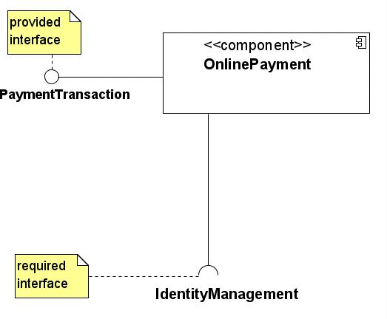
Component interfaces

Slide 15
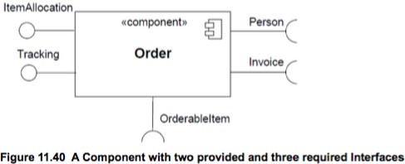
Component interfaces
A provided interface of a component is an interface that the component realizes
A required interface of a component is an interface that the component needs to function
The provided and required Interfaces of a Component may be shown by means of ball (lollipop) and socket notation, respectively.

Slide 16
Component interfaces
Class interfaces have similar notations (definitions).
Provided interfaces define “a set of public attributes and operations that must be provided by the classes that implement a given interface”.
Required interfaces define “a set of public attributes and operations that are required by the classes that depend upon a given interface”.
Java Warnings: Note that these definitions of interfaces differ from the Java definition of interfaces. The Java definition of interfaces does not allow to have attributes, nor hence state.

Slide 17
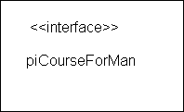
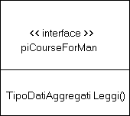

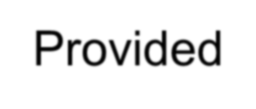

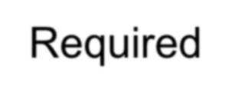
INTERFACE
May be shown using a rectangle symbol with a keyword <<interface>> preceding the name
For displaying the full signature, the interface rectangle can be expanded to show details
Can be
Provided
Required

Slide 18


INTERFACE
A provided interface
Characterize services that the component offers to its environment
Is modeled using a ball, labelled with the name,
attached by a solid line to the component
A required interface
Characterize services that the component expects from its
environment
Is modeled using a socket, labelled with the name, attached by a solid line to the component
In UML 1.x were modeled using a dashed arrow

Slide 19


INTERFACE
Where two components/classes provide and require the same interface, these two
notations may be combined
The ball-and-socket notation hint at that interface in question serves to mediate interactions between the two components
If an interface is shown using the rectangle symbol, we can use an alternative
notation, using dependency arrows

Slide 20
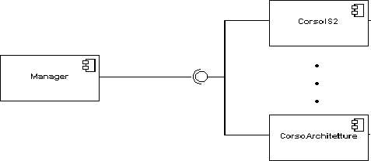
INTERFACE
In a system context where there are multiple components that require or provide a particular interface, a notation abstraction can be used that combines by joining the interfaces

Slide 21
Dependencies
Reside Dependencies: A reside dependency from a component to any UML element indicates that the component is a client of the element, which is considered itself a supplier, and that the element resides in the component.
Use Dependencies: A use dependency from a client component to a supplier components interface indicates that the client component uses or depends on the interface provided by the supplier component.
Deploy Dependency: A deploy component from a client component to a supplier node indicates that the client components is deployed on the supplier node.

Slide 22

Dependencies
Components can be connected by usage dependencies
Usage Dependency
It is a usage dependency is relationship which one element requires another element for its full implementation
It is a dependency in which the client requires the presence of the supplier
It is shown as dashed arrow with a <<use>> keyword

Slide 23
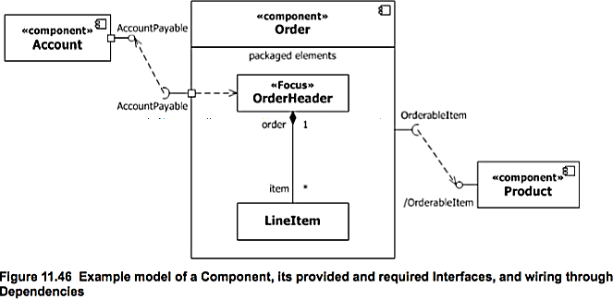
Dependencies among components

Slide 24
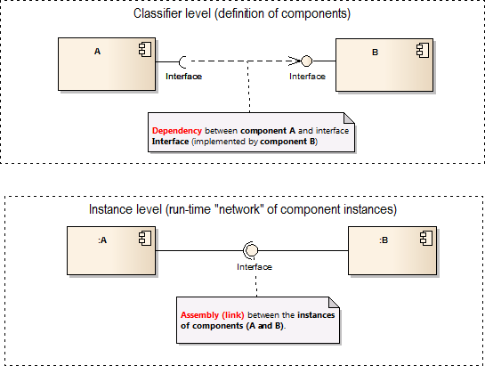
Dependencies among components

Slide 25
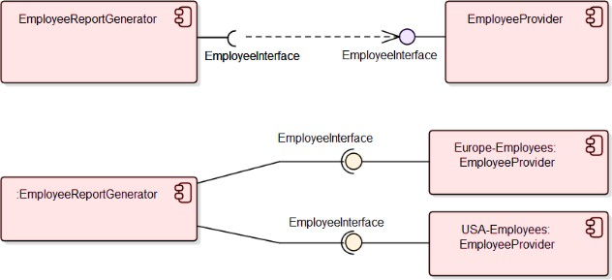
Dependencies Example

Slide 26

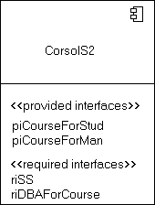
EXTERNAL VIEW
A component has an external view and an internal view
An external view (or black box view) shows publicly visible properties and operations
An external view of a component is by means of interface symbols sticking out of the component box
The interface can be listed in the compartment of a component box

Slide 27
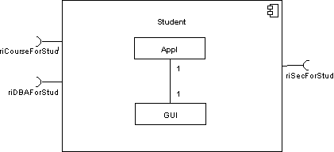
INTERNAL VIEW
An internal,
or white box view of a component is where the realizing
classes/components are nested within the component shape
Realization is a relationship between two set of model elements
One represents a specification
The other represent an implementation of the latter

Slide 28
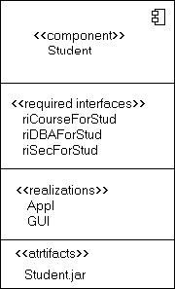
INTERNAL VIEW
The internal class that realize the behavior of a component may be displayed in an additional compartment
Compartments can also be used to display parts, connectors or implementation artifacts
An artifact is the specification of a physical piece of information

Slide 29
SEMANTICS for an Assembly Connector
The semantics for an assembly connector:
Are that signals travel along an instance of a connector originating in a required port and delivered to a provided port
The interfaces provided and required must be compatible
The interface compatibility between provided and required ports that are
connected enables an existing component in a system to be replaced

Slide 30
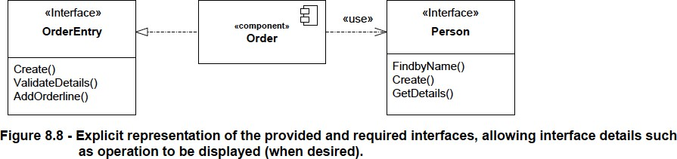
Example

Slide 31
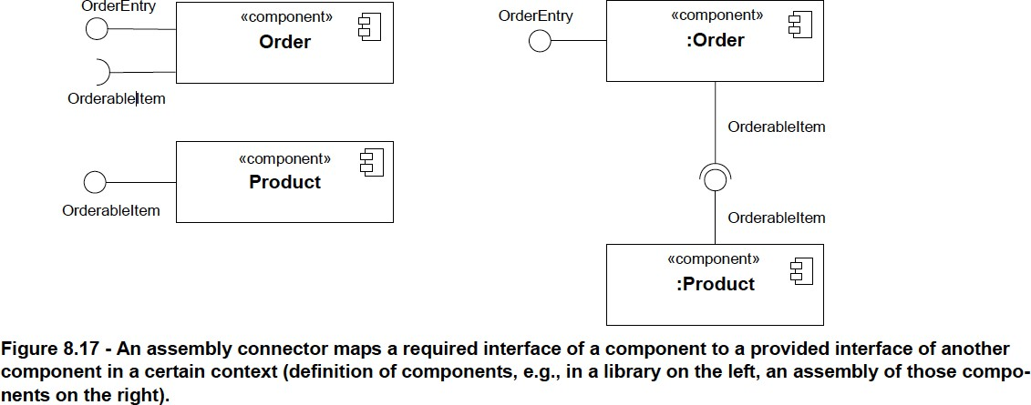
Example

Slide 32
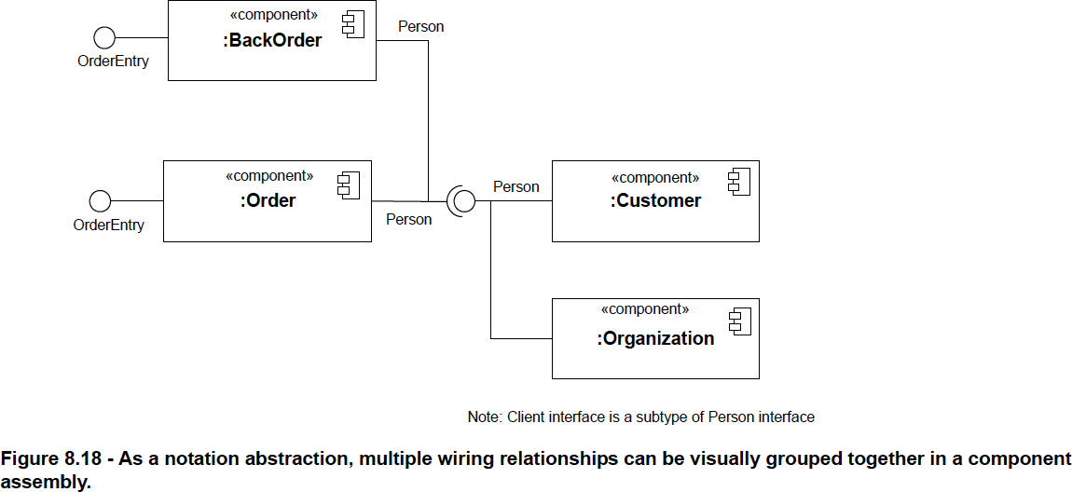
Example (Sub-type)
Client

Slide 33
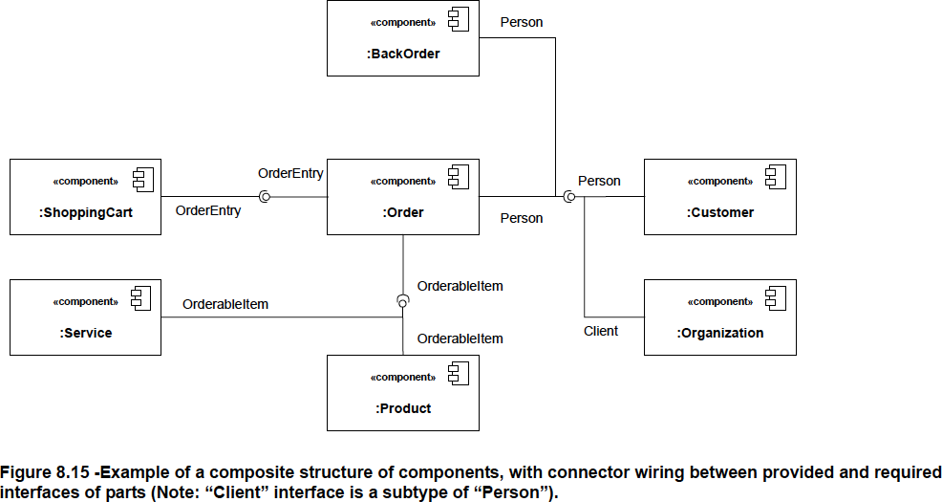
Example: Online Order Management

Slide 34
Exercise
34

Slide 35
Restaurant Booking System
To develop an Online Restaurant Booking System, the system designer has proposed four components for the customers’ booking subsystem. The Customer component provides the profileInfo interface and requires the reservationInfo and paymentInfo interface. profileInfo interface is required by the Payment component. This component provides the paymentInfo interface. There is another component named Restaurant. This one provides reservationInfo and profileInfo interfaces. The admin component requires reservationInfo, profileInfo, and transaction. Transaction interface is a sub-type of the paymentInfo interface. paymentInfo interface is provided by the Payment component and required by the restaurant component.

Slide 36
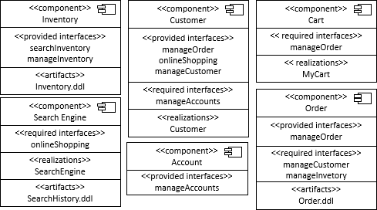
E-commerce Management

